Slide 1
Investigating the Popularity of Airbnb Listings in Singapore
Koh Jit Woon
Michelle Pang Hui Qi
Sharon Mariam Mathew
Low Yee Lee
Lim Minhan

Slide 2
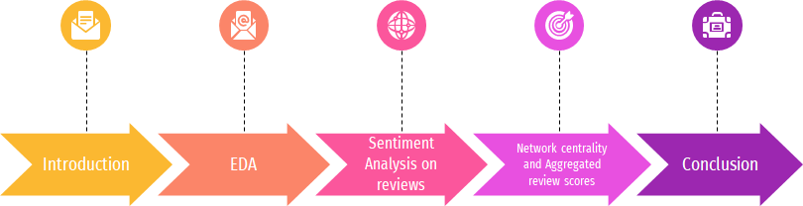
Agenda
Notes:
Reference: Identifying potential scam listings on AirBnB
https://towardsdatascience.com/identifying-potential-scam-listings-on-airbnb-e9aed41611e5

Slide 3
Introduction
To investigate popularity of active Airbnb listings in Singapore
2 datasets – Listings and Reviews
To conduct sentiment analysis on reviews
Investigate network influence (bipartite graph of reviews and listings) and identify popular attributes based on top 10 listings in each room category
Identify top 10 listings based on aggregated review scores (from sentiment analysis) and identify popular attributes for each room category

Slide 4
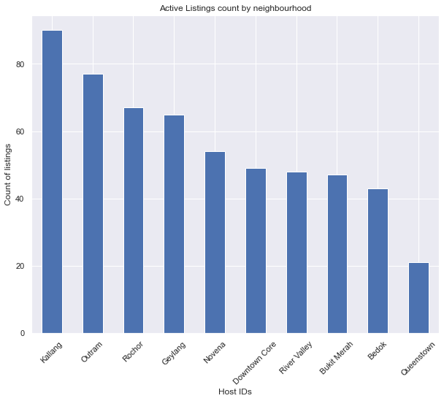



Exploratory Data Analysis (Listings)
Pre-processing steps:
Listings with no reviews are removed
Only active listings are kept (reviewed at least once in past 12 months AND booked for at least 1 night in the next 90 days)

Slide 5
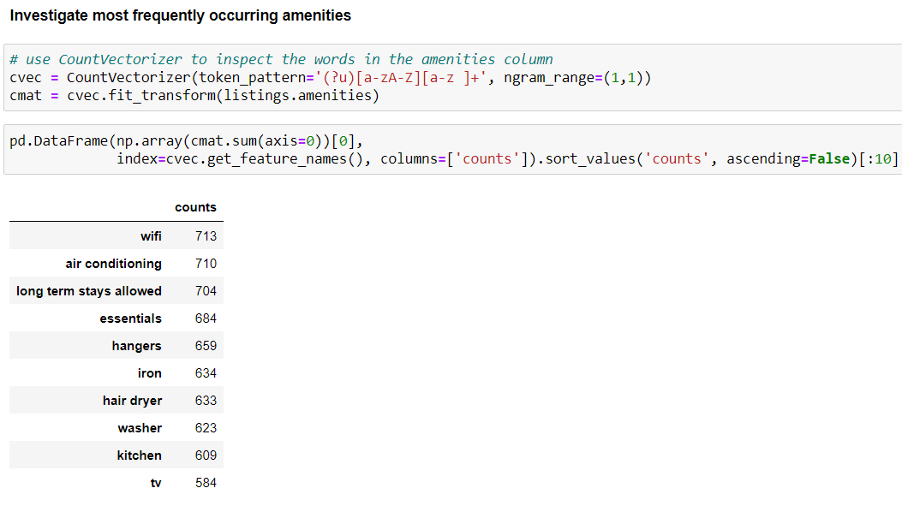
Exploratory Data Analysis (Listings)
Most frequently occurring amenities:
wifi, air-conditioning, essentials, hangers, iron, hair dryer, washer, kitchen, tv

Slide 6
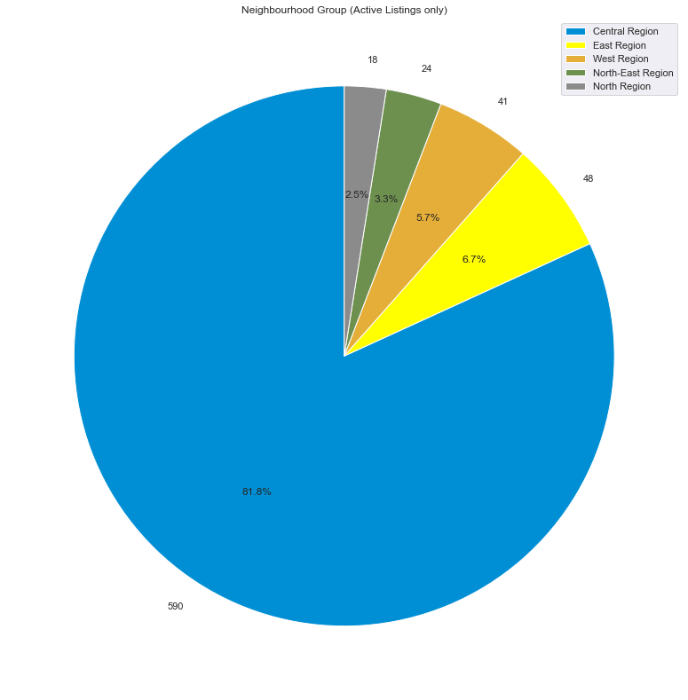
Exploratory Data Analysis (Listings)
82% of active listings are in the central region
~7% in the East
~6% in the West
Remaining 6% in other regions

Slide 7
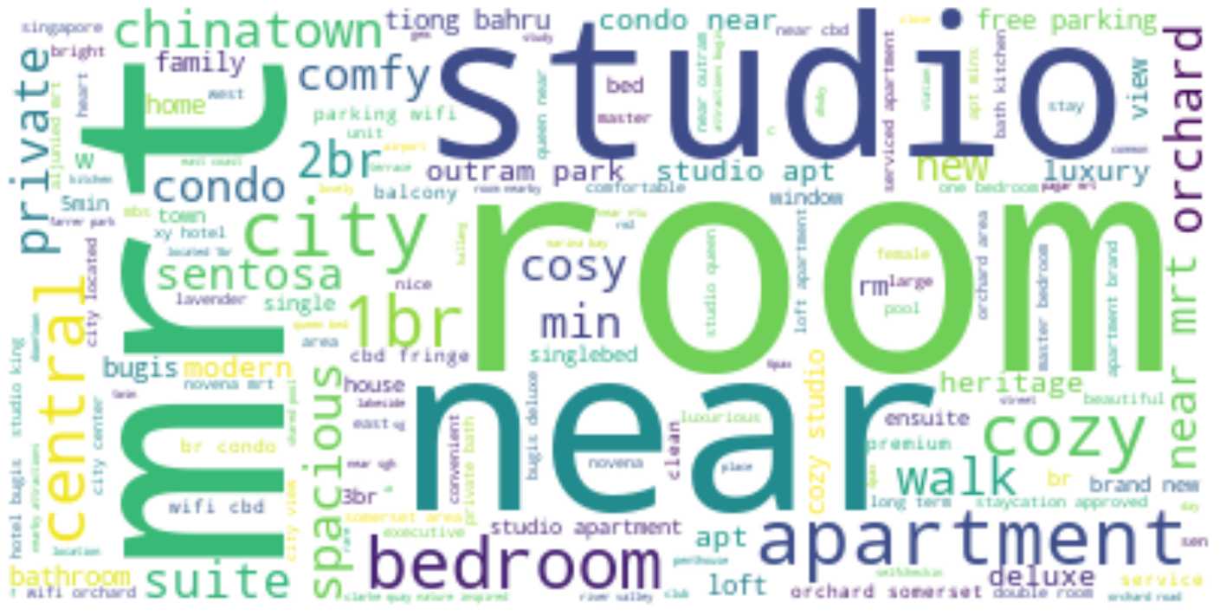
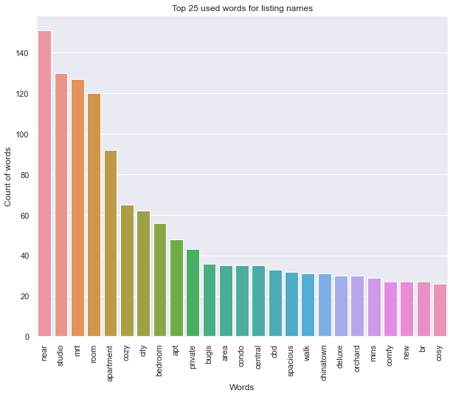
Exploratory Data Analysis (Listings)
Top Listing Words

Slide 8
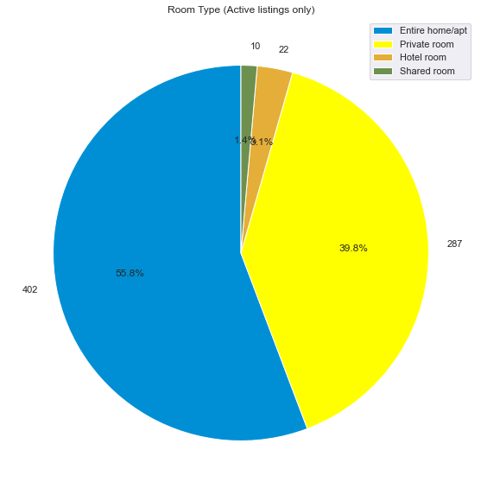
Exploratory Data Analysis (Listings)
The dataset is separated based on room type: Private room, entire home, shared room and hotel room
As the hotel room and shared room segments are too small (sample size of 22 and 10 respectively), we will focus on Entire home and Private room.

Slide 9
Exploratory Data Analysis (Reviews)
Preprocessing on the raw reviews' dataset:
Drop data with Empty comment columns
Drop data which reviews are in other languages
Drop reviews that are automated postings
'This is an automated posting'
Only reviews on currently active listings are considered

Slide 10
Exploratory Data Analysis (Reviews)
MERGING OF THE PROCESSED LISTING DATASET AND REVIEW DATASET
Only two processed listing datasets are used: Entire homes and Private homes
Preprocessing conducted on the merged dataset:
Drop unnecessary columns: description, host_location, latitude, longitude, etc.
Drop Non-ASCII characters
Æ, æ, €, ฿, etc.
Remove stop words
the, is, at, which, on
Apply Stemming

Slide 11
Sentiment Analysis
Perform sentiment analysis on corpus (datasets) using Textblob
Compute polarity score and sentiment type of Airbnb listing reviews
Find insights from the sentiment analysis scores
Textblob is based on lexicons of sentiment-related words. It uses NLTK to analyse textual data.
The output is a polarity score between -1(strongly negative) and 1(strongly positive) and indicates the sentiment of the review.
In our project, the results reveal if an Airbnb listing review is positive, negative or neutral
We focus on the top 10 positive listings by house types, namely private rooms and entire homes

Slide 12
Sentiment Analysis – private room
Central Region private rooms account for majority of positive reviews

Slide 13

Sentiment Analysis – private room
Comments from the top 10 positive reviews:
“Hospitality”
“felt at home”
“Excellent location”
“city view”
“Amazing host”
“2-3min”, “Mrt station”
“beautiful room”
“Convenient”

Slide 14
Sentiment Analysis – Entire home TYPE

Slide 15
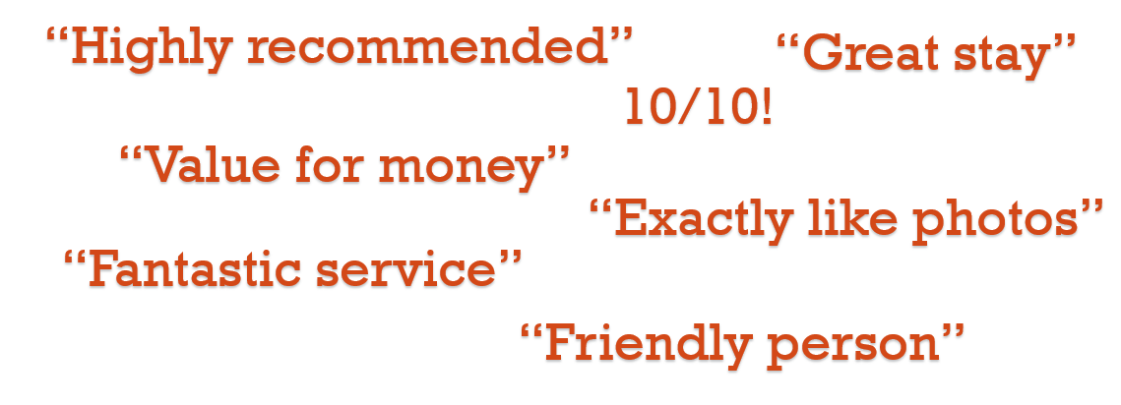
Sentiment Analysis – Entire home TYPE
Texts from the top 10 positive reviews:

Slide 16
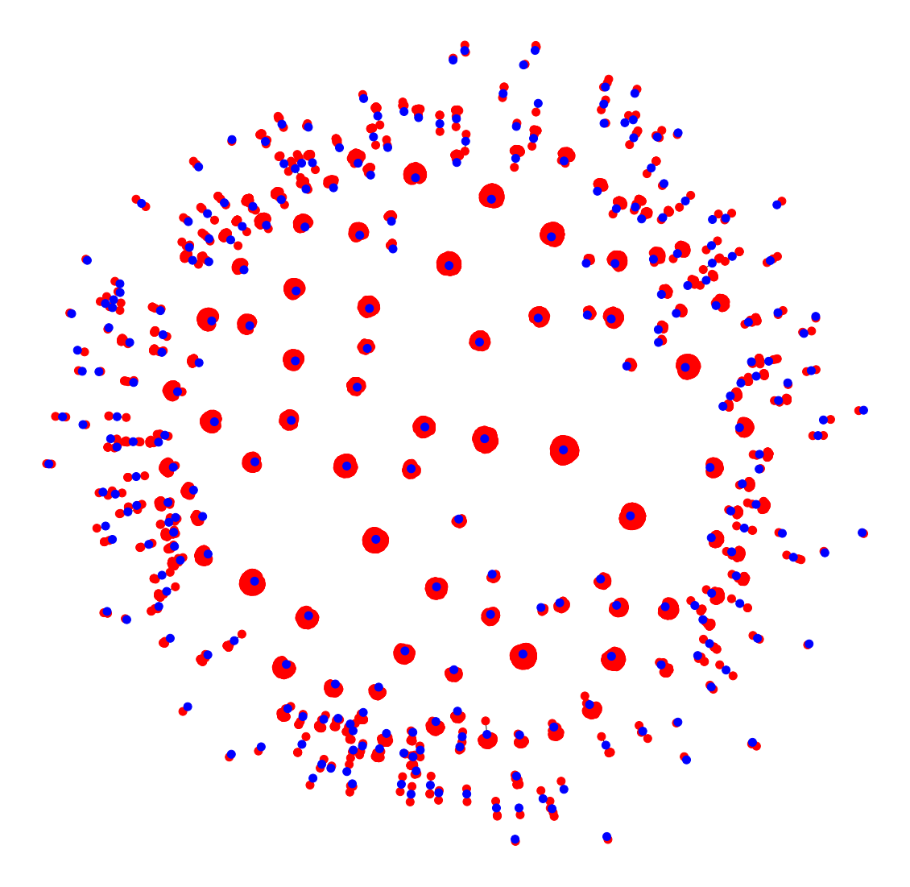
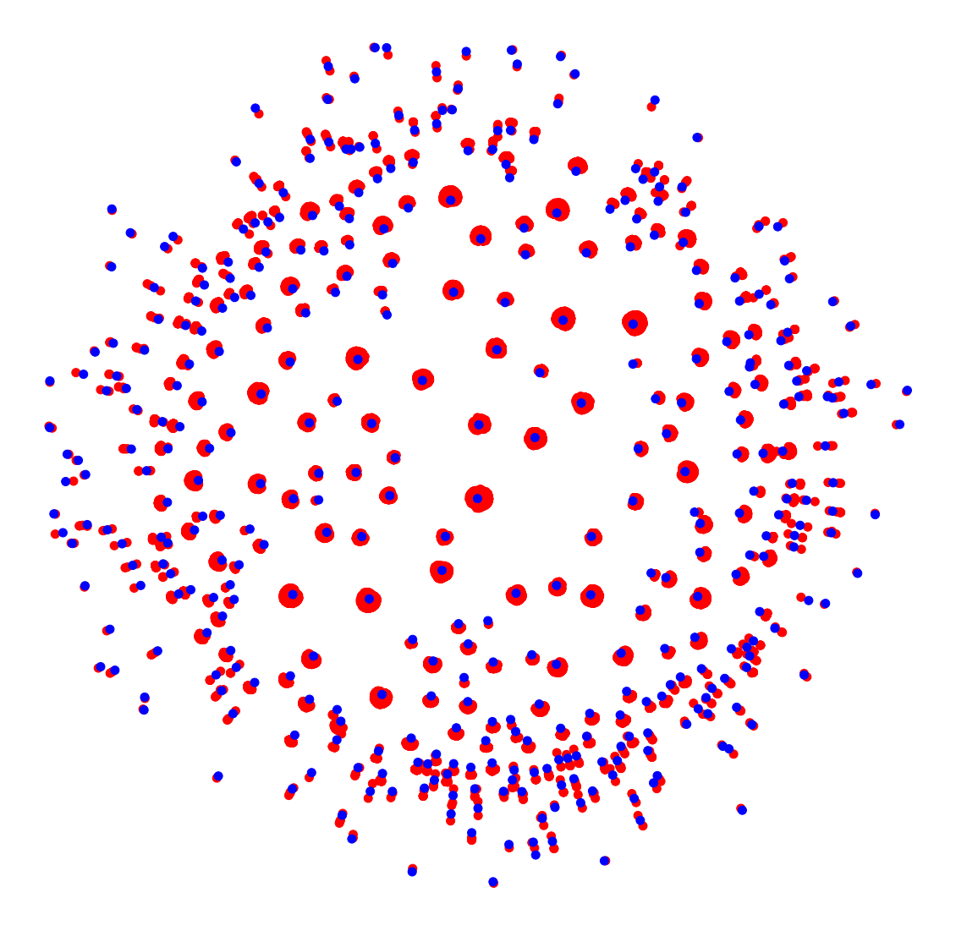
Network Influence
Bipartite graph between reviews and listings
Red : reviews
Blue : listings
Private room (8k+ reviews)
Shared room (12.9k+ reviews)

Slide 17
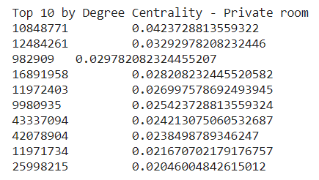
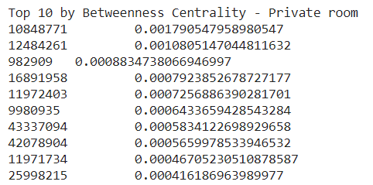
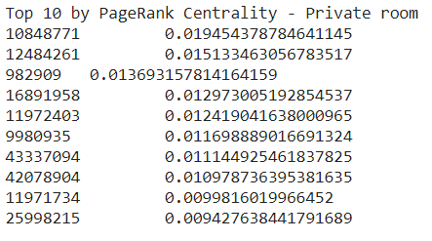
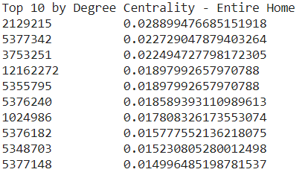
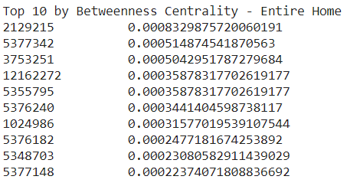
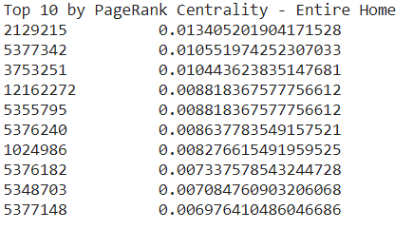
Network Influence
Top 10 nodes (listing ID) using degree centrality, betweenness centrality, pagerank

Slide 18
Top Ten listings based on centrality – Private Room
Listing ID | Neighbourhood | Region | Property type | Pax | Price
10848771 | Toa Payoh | Central Region | Private room in house | 2 | $50.00
12484261 | Kallang | Central Region | Private room in apartment | 2 | $64.00
982909 | Novena | Central Region | Private room in apartment | 1 | $70.00
16891958 | Kallang | Central Region | Private room in apartment | 2 | $80.00
11972403 | Hougang | North-East Region | Private room in house | 1 | $38.00
9980935 | Yishun | North Region | Private room in house | 2 | $28.00
43337094 | Downtown Core | Central Region | Room in boutique hotel | 2 | $53.00
42078904 | Downtown Core | Central Region | Room in boutique hotel | 2 | $98.00
11971734 | Hougang | North-East Region | Private room in house | 1 | $44.00
25998215 | Toa Payoh | Central Region | Private room in house | 2 | $45.00

Slide 19
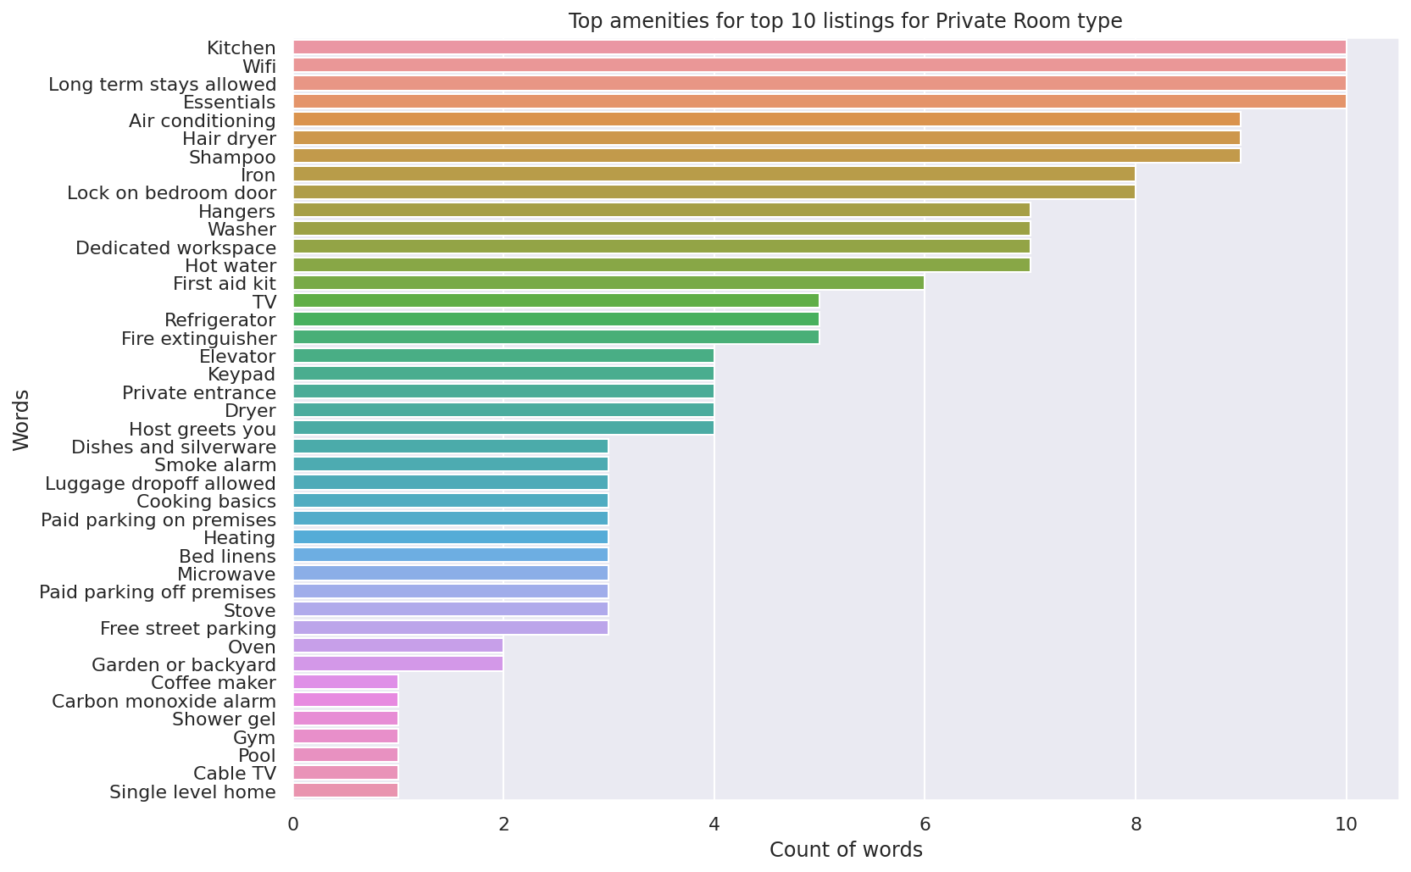
Top Ten listings based on centrality – Private Room

Slide 20
Top Ten listings based on centrality – Entire home
Listing ID | Neighbourhood | Region | Property type | Pax | Price
2129215 | Bedok | East Region | Entire townhouse | 5 | $115.00
5377342 | Rochor | Central Region | Entire apartment | 2 | $75.00
3753251 | River Valley | Central Region | Entire apartment | 5 | $160.00
12162272 | Kallang | Central Region | Entire apartment | 4 | $136.00
5355795 | Rochor | Central Region | Entire apartment | 2 | $81.00
5376240 | Rochor | Central Region | Entire apartment | 2 | $81.00
1024986 | River Valley | Central Region | Entire apartment | 2 | $134.00
5376182 | Rochor | Central Region | Entire apartment | 2 | $85.00
5348703 | Rochor | Central Region | Entire apartment | 2 | $84.00
5377148 | Rochor | Central Region | Entire apartment | 2 | $74.00

Slide 21
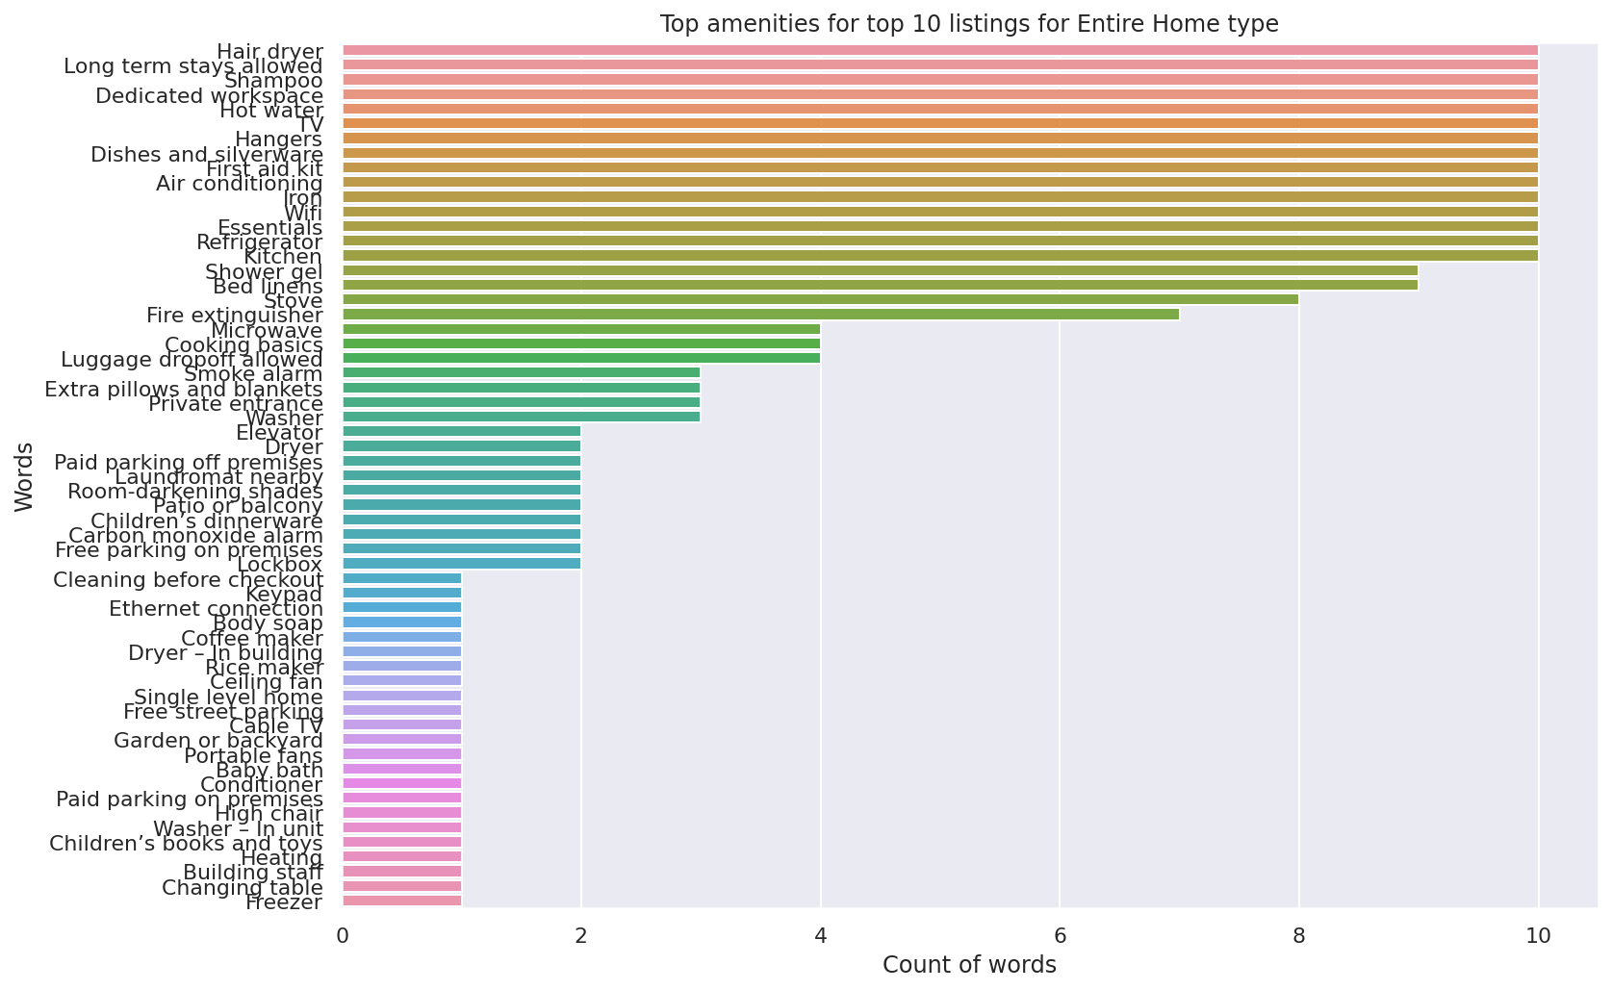
Top Ten listings based on centrality – entire HOME

Slide 22
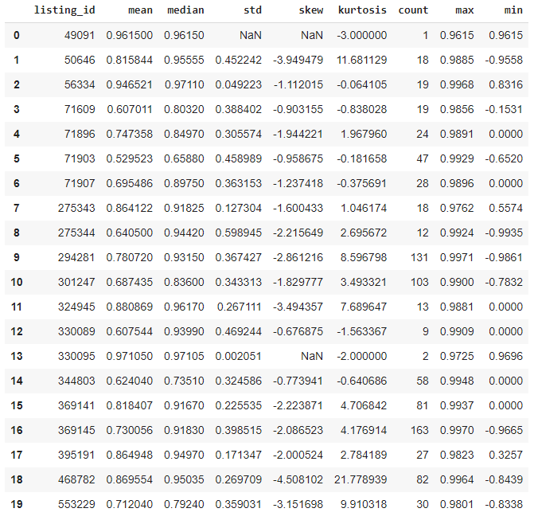
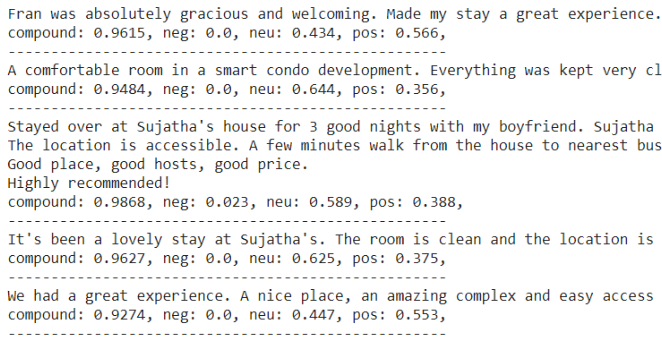
Aggregated Reviews Analysis
VADER
Notes:
VADER
VADER ( Valence Aware Dictionary for Sentiment Reasoning) is a model used for text sentiment analysis that is sensitive to both polarity (positive/negative) and intensity (strength) of emotion. It is available in the NLTK package and can be applied directly to unlabeled text data.
VADER sentimental analysis relies on a dictionary that maps lexical features to emotion intensities known as sentiment scores. The sentiment score of a text can be obtained by summing up the intensity of each word in the text.
For example- Words like ‘love’, ‘enjoy’, ‘happy’, ‘like’ all convey a positive sentiment. Also VADER is intelligent enough to understand the basic context of these words, such as “did not love” as a negative statement. It also understands the emphasis of capitalization and punctuation, such as “ENJOY”

Slide 23
Top Ten listings based on Reviews – PRIVATE ROOM
Listing ID | Neighbourhood | Region | Property type | Pax | Price
7765392 | Kallang | Central Region | Private room in apartment | 1 | $53.00
6638508 | Kallang | Central Region | Private room in apartment | 1 | $68.00
33490643 | Bishan | Central Region | Private room in condominium | 1 | $65.00
18905203 | Clementi | West Region | Private room in house | 1 | $40.00
16370834 | Serangoon | North-East Region | Private room in townhouse | 2 | $75.00
982909 | Novena | Central Region | Private room in apartment | 1 | $70.00
6718219 | Serangoon | North-East Region | Private room in house | 2 | $100.00
35744548 | Serangoon | North-East Region | Private room in house | 1 | $70.00
38734382 | Punggol | North-East Region | Private room in apartment | 2 | $43.00
819044 | Marine Parade | Central Region | Private room in apartment | 2 | $150.00
Interesting Review Phrases
“heart of the East side of Singapore”
“most delicious quiche and salad”
“just what I needed after all my medical stuff in Singapore”
“Funky apartment with quirky features”
“Yuan is amazing host!”
“Rainer makes the best spare-ribs with his own BBQ sauce”
“Authentic, quirky, stylish and fun”
“fantastic British themed pub serving delicious grub”

Slide 24
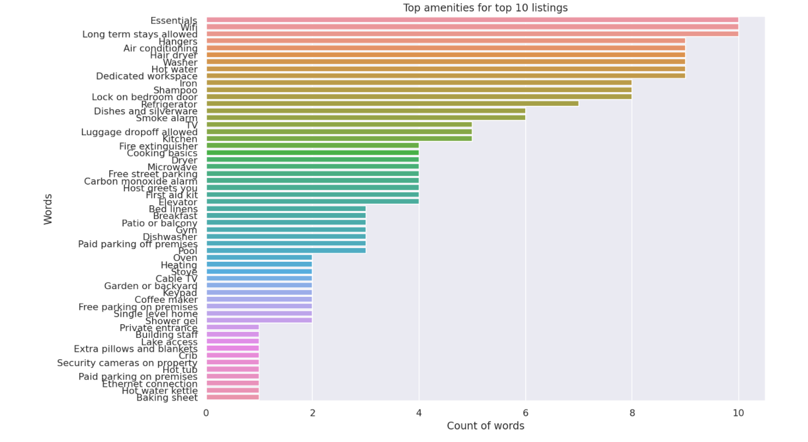
Top Ten listings based on Reviews – PRIVATE ROOM

Slide 25
Top Ten listings based on Reviews – Entire home
Listing ID | Neighbourhood | Region | Property type | Pax | Price
2129215 | Bedok | East Region | Entire townhouse | 5 | $115.00
18517165 | Bedok | East Region | Entire condominium | 4 | $129.00
11871765 | Novena | Central Region | Entire house | 2 | $105.00
31457968 | Downtown Core | Central Region | Entire condominium | 2 | $100.00
14718255 | Outram | Central Region | Entire apartment | 2 | $83.00
31527262 | Southern Islands | Central Region | Boat | 2 | $210.00
13038831 | Kallang | Central Region | Entire apartment | 5 | $129.00
3877859 | Bukit Panjang | West Region | Entire condominium | 5 | $155.00
7311328 | Novena | Central Region | Entire house | 5 | $400.00
8061522 | Tanglin | Central Region | Entire condominium | 6 | $260.00
Interesting Review Phrases
“There is a personalized welcome sign in the apartment”
“variety of snacks and beverages for you to enjoy”
“We don't meet people by accident”
“She even gave my daughter ice cream and milk!”
“he was responsive to all my messages & requests”
“the lure of falling asleep under the stars in a serene setting”
“The neighbourhood was modern and had a European feel”
“The amazing pool also makes all of us relaxed”

Slide 26
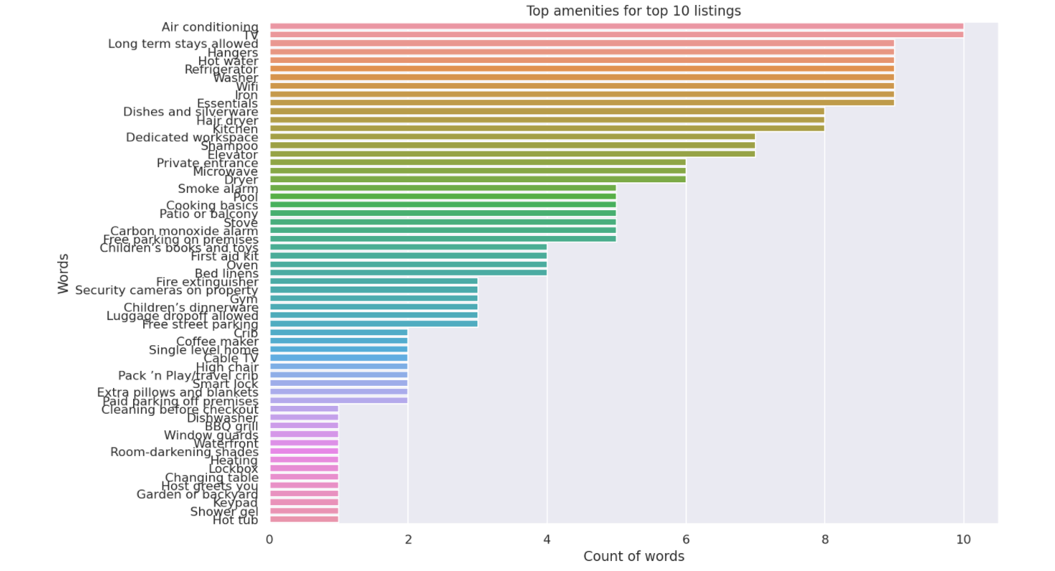
Top Ten listings based on Reviews – Entire home

Slide 27
Limitations
Reviews containing non-ASCII characters and non-English reviews are omitted completely, so the remaining reviews in English may not be truly representative of sentiment towards listings.
Reviews that have either no comments or has an automated message were dropped and not considered.
Multiple listings of the same house can be made.
Our dataset is small, so insights are limited
Popularity of listings is influenced by many factors other than amenities, such as price, location, quality of host etc. Will require a more complex model to quantify the importance of listing attributes relative to one another

Slide 28
Conclusion & recommendations
Insights & Key Takeaways
Insights from both network centrality and sentiment analysis showed that cleanliness, availability of basic amenities and the centrality of locations such that proximity to attractions/easy access to transportation are common attributes in top reviews and are essentials to capture the audience
Most positive reviews are centred around hosts who with personal touches
Recommendation for Operators
Investigative purpose against fraud.
Identify “top” friendly hosts to explore more business possibilities
Recommendation for Users
Attract targeted market – medical tourism, business travellers, live-onboard
Appeal to emotions to sell, e.g. “the lure of falling asleep under the stars ”

Slide 29
Top Ten listings based on Reviews – PRIVATE ROOM
To create separate bar plot for amenities and remove from table (too wordy) – MH-noted.
Listing ID | Neighbourhood | Region | Property type | Pax | Amenities | Price
7765392 | Kallang | Central Region | Private room in apartment | 1 | ["Coffee maker", "Hair dryer", "Free street parking", "Dishwasher", "Washer", "Wifi", "Iron", "Host greets you", "Paid parking off premises", "Hot water“, …] | $53.00
6638508 | Kallang | Central Region | Private room in apartment | 1 | ["Hair dryer", "Dishwasher", "Ethernet connection", "Washer", "Wifi", "Iron", "Fire extinguisher", "Host greets you", "Shower gel", "Paid parking off premises”, …] | $68.00
33490643 | Bishan | Central Region | Private room in condominium | 1 | ["Hair dryer", "Washer", "Wifi", "First aid kit", "Hot water", "Dedicated workspace", "Lock on bedroom door", "Security cameras on property", "Extra pillows and blankets", "Air conditioning“, …] | $65.00
18905203 | Clementi | West Region | Private room in house | 1 | ["Hair dryer", "Kitchen", "Free street parking", "Free parking on premises", "Washer", "Wifi", "Iron", "Cooking basics", "TV", "Hot water", …] | $40.00
16370834 | Serangoon | North-East Region | Private room in townhouse | 2 | ["Hair dryer", "Free street parking", "Carbon monoxide alarm", "Washer", "Breakfast", "Wifi", "Iron", "Fire extinguisher", "First aid kit", "TV", …] | $75.00
982909 | Novena | Central Region | Private room in apartment | 1 | ["Coffee maker", "Hair dryer", "Heating", "Kitchen", "Carbon monoxide alarm", "Keypad", "Washer", "Paid parking on premises", "Wifi", "Iron", …] | $70.00
6718219 | Serangoon | North-East Region | Private room in house | 2 | ["Hangers", "Lock on bedroom door", "Hair dryer", "Iron", "Heating", "Wifi", "Dedicated workspace", "Kitchen", "Free street parking", "Free parking on premises", …] | $100.00
35744548 | Serangoon | North-East Region | Private room in house | 1 | ["Hair dryer", "Kitchen", "Carbon monoxide alarm", "Keypad", "Washer", "Breakfast", "Hot water kettle", "Wifi", "Iron", "Fire extinguisher", …] | $70.00
38734382 | Punggol | North-East Region | Private room in apartment | 2 | ["Essentials", "Lock on bedroom door", "Wifi", "Long term stays allowed"] | $43.00
819044 | Marine Parade | Central Region | Private room in apartment | 2 | ["Hair dryer", "Kitchen", "Carbon monoxide alarm", "Dishwasher", "Washer", "Breakfast", "Wifi", "Iron", "Cooking basics", "TV", …] | $150.00

Slide 30
Top Ten listings based on Reviews – Entire home
Listing ID | Neighbourhood | Region | Property type | Pax | Amenities | Price
31457968 | Bedok | East Region | Entire townhouse | 5 | ["Hair dryer", "Kitchen", "Free street parking", "Free parking on premises", "Carbon monoxide alarm", "Washer", "Wifi", "Iron", "First aid kit", "Cooking basics”, …] | $115.00
14718255 | Bedok | East Region | Entire condominium | 4 | ["Hair dryer", "Kitchen", "Free parking on premises", "Carbon monoxide alarm", "Keypad", "Washer", "Wifi", "Iron", "Children\u2019s books and toys", "TV“, …] | $129.00
11871765 | Novena | Central Region | Entire house | 2 | ["Hair dryer", "Kitchen", "Free parking on premises", "Washer", "High-chair", "Pack \u2019n Play/travel crib", "Iron", "Fire extinguisher", "Wifi", "First aid kit“, …] | $105.00
31457968 | Downtown Core | Central Region | Entire condominium | 2 | ["Hangers", "Hair dryer", "Iron", "Wifi", "Kitchen", "Elevator", "Shampoo", "Private entrance", "Long term stays allowed", "Air conditioning", … | $100.00
14718255 | Outram | Central Region | Entire apartment | 2 | ["Hangers", "Hair dryer", "Iron", "Heating", "Wifi", "Kitchen", "Refrigerator", "Elevator", "Long term stays allowed", "Air conditioning", …] | $83.00
31527262 | Southern Islands | Central Region | Boat | 2 | ["Coffee maker", "Security cameras on property", "Fire extinguisher", "Smoke alarm", "First aid kit", "Refrigerator", "Dishes and silverware", "Private entrance", "Waterfront", "Carbon monoxide alarm", …] | $210.00
13038831 | Kallang | Central Region | Entire apartment | 5 | ["Hair dryer", "Kitchen", "Carbon monoxide alarm", "Washer", "Wifi", "Iron", "Window guards", "Cooking basics", "TV", "Oven", …] | $129.00
3877859 | Bukit Panjang | West Region | Entire condominium | 5 | ["Coffee maker", "Hair dryer", "Kitchen", "Free street parking", "Free parking on premises", "Washer", "High-chair", "Pack \u2019n Play/travel crib", "Iron”, …] | $155.00
7311328 | Novena | Central Region | Entire house | 5 | ["Hair dryer", "Free street parking", "BBQ grill", "Carbon monoxide alarm", "Dishwasher", "Washer", "Cleaning before checkout", "Wifi", "Iron", "Fire extinguisher“, …] | $400.00
8061522 | Tanglin | Central Region | Entire condominium | 6 | ["Hangers", "Wifi", "Iron", "Kitchen", "Refrigerator", "Elevator", "Dishes and silverware", "Free parking on premises", "Stove", "Long term stays allowed", …] | $260.00

